Slide 1
Comparative Analysis of Mortality Rate Prediction in Critical Care Patients: Neural Network vs. Classical Machine Learning Models using US Healthcare Data
Yuta Tsukumo, M.D., MPH
Candidate for a Master of Science in Statistical Practice

Slide 2

About me
From Japan
Gastroenterological surgeon
Work for Ministry of Ministry of Health, Labour and Welfare
Father of three kids

Slide 3
Personal Motivation
Deep learning is applied in medical contexts like image diagnosis and intraoperative image recognition.
However, so far there are few examples of evidence from deep learning analysis being used for national healthcare policy in Japan.
By comparing deep learning with traditional machine learning, I aim to grasp their respective strengths and weaknesses, aspiring to contribute to the advancement of the data science in healthcare in Japan.

Slide 4



Study Background
Predicting mortality rates for critically ill patients requiring intensive care is essential for
Allocation of limited medical staff / equipment
Assessing quality of treatment facilities
Appropriately classifying severity for clinical research.

Slide 5
Aim
To create a mortality prediction model for intensive care unit admissions using traditional machine learning methods and deep learning.

Slide 6
Data
Data Source:
The GLOBAL OPEN SOURCE SEVERITY OF ILLNESS SCORE (GOSSIS) Consortium https://gossis.mit.edu/
Kaggle https://www.kaggle.com/datasets/mitishaagarwal/patient
91,714 rows (patients) and 85 columns (31.4MB)
Variables
Patient demography (Age, Gender, Race, BMI, etc.)
Hospitalization (ICU type, Elective surgery, etc.)
Medical condition (Apache scores, blood pressure, Heart Rate, Respiratory Rate, etc.)
Comorbidity (Diabetes, Immunodeficiency, etc.)
Data Partitioning Training data 70%, Test data 30%

Slide 7
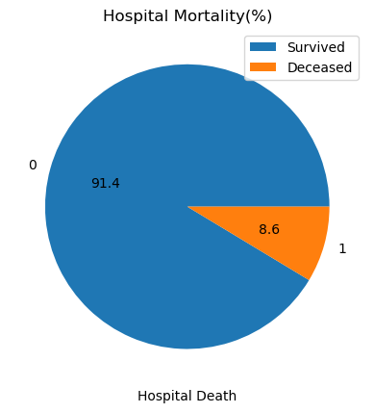
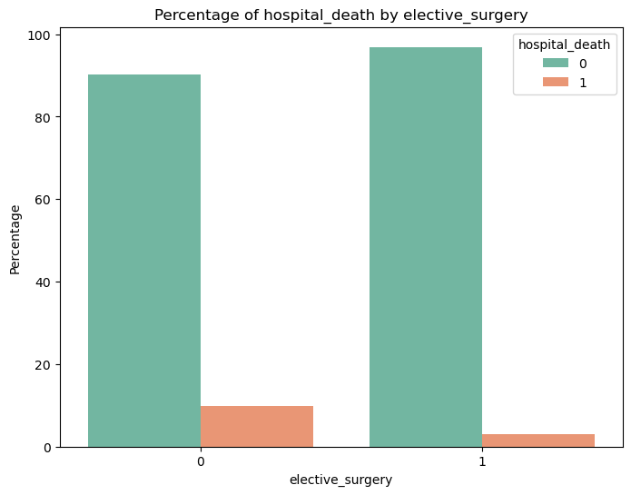
EDA (excerpts 1)

Slide 8
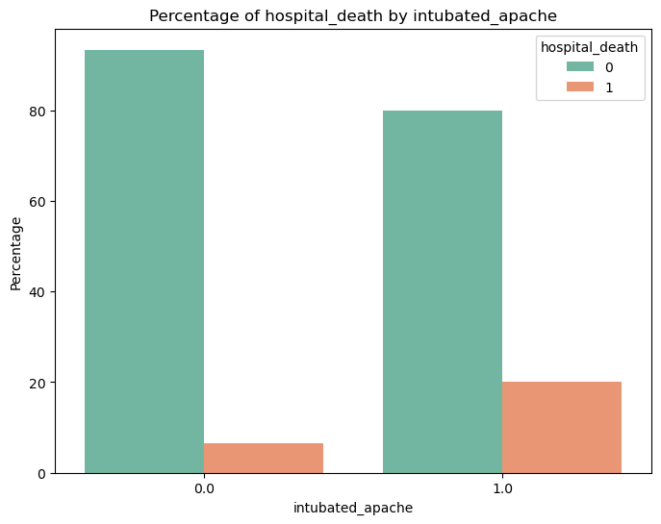
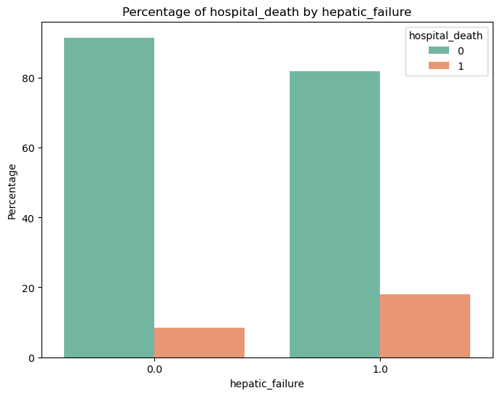
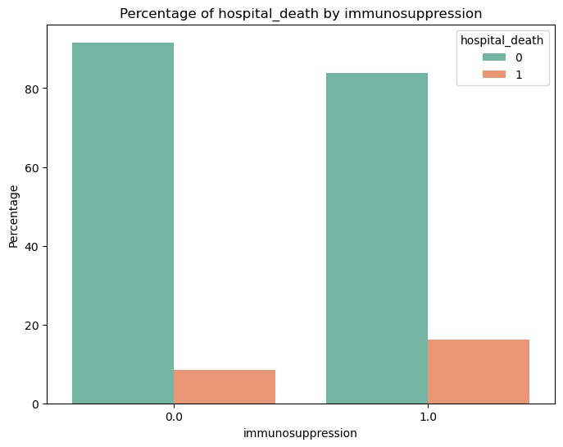
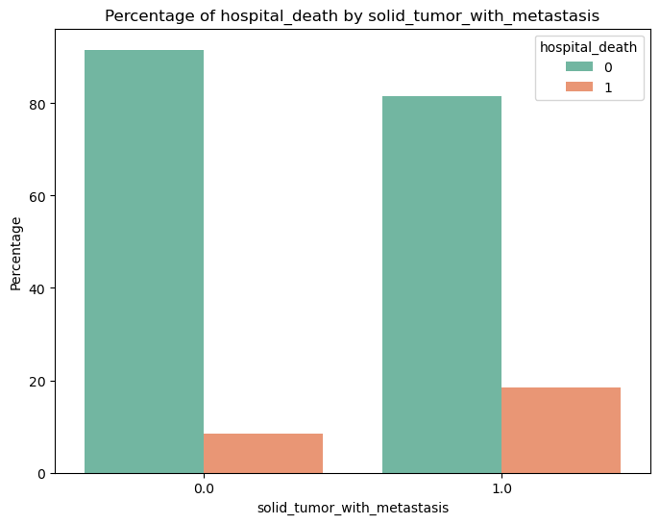
EDA (excerpts 2)

Slide 9
Methods
29 variables from 85 columns were selected as inputs based on EDA results and medical knowledge.
Age, BMI, Days Before ICU Admission, GCS scores, Heart Rate, Arterial Pressure, Respiratory Rate, Elective Surgery, Ethnicity, Gender, Source of ICU Admission, Types of ICU, Post-Operative, Atrial Fibrillation, Intubated, Ventilated, AIDS , Cirrhosis, Diabetes, Hepatic Failure, Immunosuppression, Leukemia, Lymphoma, Solid Tumor with Metastasis
Missing values of continuous/ integers variables were imputed by means. Rows with missing values for categorical variables were excluded in the analysis.
Because of the imbalance in binary outcomes, ROC AUC and Matthews Correlation Coefficient (MCC) were used instead of Accuracy to compare models.
Notes:
AUC: AUC measures the ability of the model to distinguish between positive and negative classes across all possible thresholds. It is robust to class imbalance because it considers the rank order of predictions rather than their absolute values. AUC ranges from 0 to 1, where a higher value indicates better discrimination.
Matthews Correlation Coefficient (MCC): MCC takes into account true positives, true negatives, false positives, and false negatives. It is also robust to class imbalance and is particularly useful when classes are imbalanced. MCC ranges from -1 to 1, where 1 indicates perfect prediction, 0 indicates random prediction, and -1 indicates complete disagreement between prediction and observation
Under the receiver operating characteristic curve (ROC AUC)

Slide 10
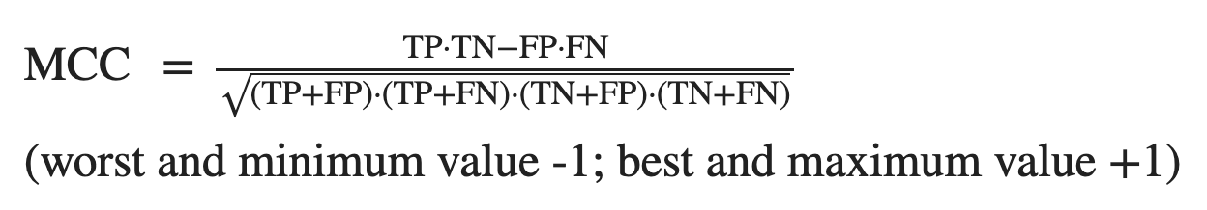
Matthew Correlation Coefficient (MCC)
ROC AUC is the most popular metric for evaluating binary outcome models, but it doesn’t provide information about precision and negative predictive value.
High value of MCC always corresponds to high values for each of the four basic rates: sensitivity, specificity, precision, and negative predictive value
Chicco D, Jurman G. The Matthews correlation coefficient (MCC) should replace the ROC AUC as the standard metric for assessing binary classification. BioData Min. 2023 Feb 17;16(1):4. doi: 10.1186/s13040-023-00322-4. PMID: 36800973; PMCID: PMC9938573.

Slide 11

Neural Network
Fitted with Three Model (Hidden layer = 1, 2 or 5)
Input layer: 62 Nodes
Optimizer: Adam
Loss Function: Binary Cross-Entropy Loss
Fixed Hyperparameters
Weight = 12 (Death) : 1 (Survive)
Learning Rate = 0.001
Weight Decay = 0.001
Hyperparameter Tuning (5- fold Cross Validation)
Dimensionality of Each Hidden Layer
Dropout Proportion
Batch Size
Epochs

Slide 12
Result
Model | ROC AUC | MCC | (Accuracy)
Logistic Regression | 0.836 | 0.275 | 0.919
Random Forests | 0.849 | 0.291 | 0.922
Gradient Boosting | 0.856 | 0.288 | 0.922
GAM (Generalized Additive Model) | 0.856 | 0.328 | 0.922
Support Vector Machine | 0.708 | 0.203 | 0.9182
Shallow Networks (Hidden Layer = 1) Dimensionality: Layer 1 = 16), Dropout Prob = 0.3, Batch Size = 32, Epochs =20 | 0.830 | 0.341 | 0.808
Deep Networks (Hidden Layer = 2) Dimensionality: Layer 1 = 32, Layer 2 = 16 Dropout Prob = 0.3, Batch Size = 32, Epochs =20 | 0.819 | 0.339 | 0.816
Deep Networks (Hidden Layer = 5) Dimensionality: Layer 1 = 64, Layer 2 = 64, Layer 3 = 32, Layer 4 = 16, Layer 5 = 8) Dropout Prob = 0.3, Batch Size = 16, Epochs =5 | 0.789 | 0.294 | 0.737

Slide 13
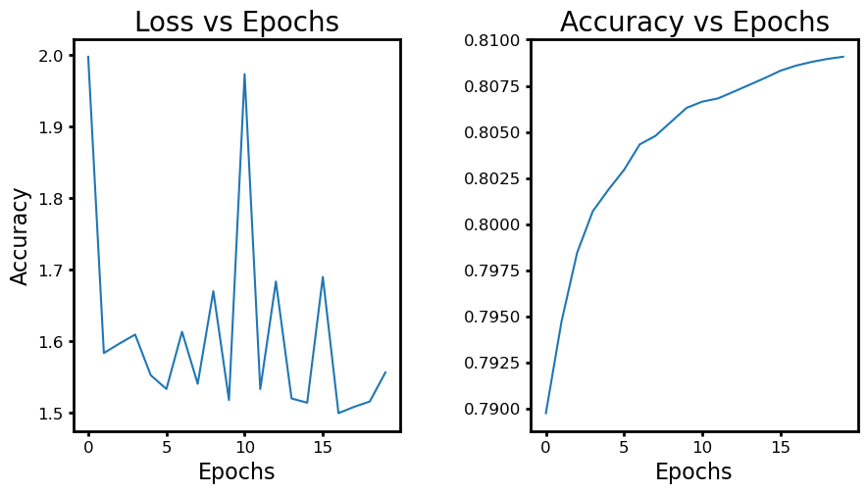
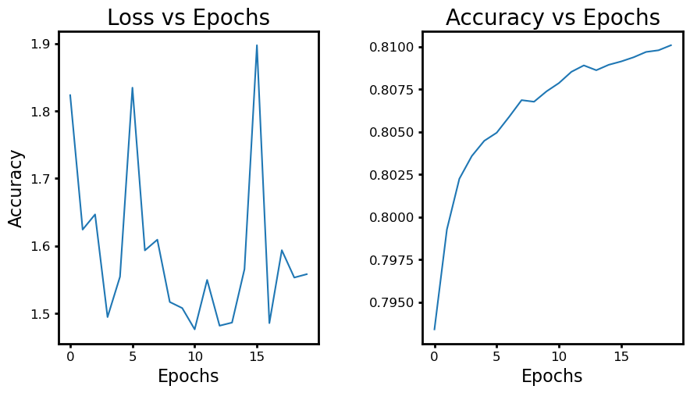
Learning Curve
Shallow Networks
Deep Networks (Layers = 2)
Deep Networks (Layers = 5)

Slide 14
Summary (Results)
The results of the comparison between classical machine learning models and deep learning showed that the Generalized Additive Model (GAM) performed best (ROC AUC=0.856, MCC = 0.328).
In neural networks, models with shallower hidden layers performed better

Slide 15
Discussion
Deep learning is rapidly being adopted in the medical field, particularly in diagnostic imaging. However, for simpler analyses such as mortality prediction, deep learning may not necessarily outperform classical machine learning models.
However, the hyperparameters in this study were not exhaustively analyzed. Better performance with deep learning may be achievable through more sophisticated tuning.
Notes:
Apache score performance varied across reports (0.75-0.98)
Varghese YE, Kalaiselvan MS, Renuka MK, Arunkumar AS. Comparison of acute physiology and chronic health evaluation II (APACHE II) and acute physiology and chronic health evaluation IV (APACHE IV) severity of illness scoring systems, in a multidisciplinary ICU. J Anaesthesiol Clin Pharmacol. 2017 Apr-Jun;33(2):248-253. doi: 10.4103/0970-9185.209741. PMID: 28781454; PMCID: PMC5520601.

